Slide 1
INFORMATION RETRIEVAL SYSTEMS (IRS)
Course Instructor
P.Veera Swamy
Assistant Professor

Slide 2
UNIT-2:SYLLABUS
Data Structures: Introduction, Stemming Algorithms, Inverted file structures, N-gram Data structures, PAT data structures, Signature file structures, Hypertext data structures
Cataloguing and Indexing: Objectives, Indexing Process, Automatic Indexing, and Information Extraction

Slide 3
DATA STRUCTURES

Slide 4

INTRODUCTION TO DATA STRUCTURES
There are usually two major data structures in any information system. These are
One structure stores and manages the received items in their normalized form.(“document manager.“)
The other major data structure contains the processing tokens and associated data to support search.

Slide 5

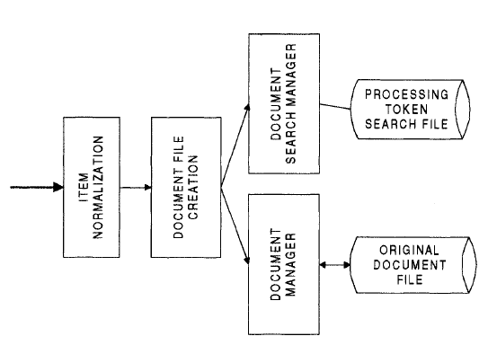

Slide 6

One of the first transformations often applied to data before placing it in the searchable data structure is stemming.
Stemming reduces the diversity of representations of a concept (word) to a canonical morphological representation.
The risk with stemming is that concept discrimination information may be lost in the process, causing a decrease in precision and the ability for ranking to be performed.
On the positive side, stemming has the potential to improve recall.

Slide 7

DATA STRUCTURES
The most common data structures encountered in both database and information systems are given below
Inverted File Structure
The most common data structure encountered in both data base and information systems
N-Gram Data Structure
Breaks processing tokens into smaller string units (which is why it is sometimes discussed under stemming) and uses the token fragments for search. improved efficiencies and conceptual manipulations over full word inversion
PAT Data Structure
PAT trees and arrays view the text of an item as a single long stream versus a juxtaposition of words. Around this paradigm search algorithms are defined based upon text strings.
Signature File Structure
Based upon the idea of fast elimination of non-relevant items reducing the searchable items to a manageable subset
The subset can be returned to the user for review or other search algorithms may be applied to it to eliminate any false hits that passed the signature filter.

Slide 8

DATA STRUCTURES
Hypertext and XML Data Structure
Use on the Internet. This structure allows the creator of an item to manually or automatically create imbedded links within one item to a related item.
Hidden Markov Model (HMM)
A HMM can be understood by first defining a discrete Markov Process.

Slide 9
STEMMING ALGORITHMS
Goal of Stemming
To improve performance and require less system resources by reducing the number of unique words that a system has to contain.
Increase in storage and computing power, use of stemming for performance reasons is no longer as important.
Stemming is now being reviewed for the potential improvement it can make recall versus its associated decline in precision.

Slide 10

INTRODUCTION TO THE STEMMING PROCESS
Stemming algorithms are used to improve the efficiency of the information system and to improve recall.
The premise is that the stem carries the meaning of the concept associated with the word and the that affixes (endings) introduce subtle modifications to the concept or are used for syntactical purposes.
The idea of equating multiple representations of a word as a single stem term would appear to provide significant compression with associated savings.
Ex: the stem "comput“ could associate "computable,
computability, computation,
computational, computerese,
computed, computing, computer,
computerize" to one compressed word.

Slide 11

Stemming can
also cause problems for Natural
Language Processing (NLP)
The most common stemming algorithm removes suffixes and prefixes, sometimes recursively, to derive the final stem.
Other techniques such as table lookup and successor stemming provide alternatives that require additional overheads.Table lookup requires a large data structures, Successor stemmers determine prefix overlap as the length of a stem is increased.

Slide 12

PORTER STEMMING ALGORITHM
The Porter Algorithm is based upon
a set of
conditions of the stem, suffix and prefix and associated actions given the condition.
Some examples of stem conditions are:
1. The measure, m, of a stem is a function of sequences of vowels (a, e, i,o, u, y) followed by a consonant. If V is a sequence of vowels and C is a sequence of consonants, then m is:
C(VC)^{m}V
where the initial C and final V are optional and m is the number VC repeats.

Slide 13

Ex:
Measure | Example
m=0 | free, why
m=l | frees, whose
m=2 | prologue, compute
2. *<X>
3. *v*
*d
*o
stem ends with letter X
stem contains a vowel
stem ends in double consonant
stem ends with consonant-vowel-
consonant sequence where the final consonant is not w, x, or y

Slide 14

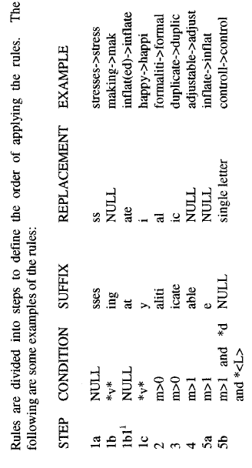
EXAMPLE

Slide 15
DICTIONARY LOOK UP STEMMERS
Simple stemming rules still may be applied.
The rules are taken from those that have the fewest exceptions (e.g., removing pluralization from nouns).
The original term or stemmed version of the term is looked up in a dictionary and replaced by the stem that best represents it.
This technique has been implemented in the INQUERY and Retrieval Ware Systems.

Slide 16
DICTIONARY LOOK UP STEMMERS
The INQUERY system uses a stemming technique called Kstem.
Kstem is a morphological analyzer that conflates word variants to a root form.
It tries to avoid collapsing words with different meanings into the same root.
Ex: "memorial" and "memorize" reduce to "memory." But "memorial" and "memorize" are not synonyms and have very different meanings.
Kstem requires a word to be in the dictionary before it reduces one word form to another.
Some endings are always removed even if the root form is not found in the dictionary(eg: ’ness’ , ’ly’)

Slide 17
The Kstem system uses the six major data files to control and limit the stemming process
Dictionary of words (lexicon)
Supplemental list of words for the dictionary
Exceptions list for those words that should retain an "e" at the end (e.g., "suites" to "suite" but "suited" to "suit")
4. Direct_Conflation -
allows definition of direct pairs that override the
conflation via word
stemming algorithm
5. Country_Nationality - conflations nationalities and countries ("British" "Britain")
between maps to
6. Proper Nouns - a list of proper nouns that should not be stemmed.

Slide 18

SUCCESSOR STEMMERS
Successor stemmers are based upon the length of prefixes that optimally stem expansions of additional suffixes.
The algorithm is based upon an analogy in structural linguistics that investigated word and morpheme boundaries based upon file distribution of phonemes, the smallest unit of speech that distinguish one word from another .
The process determines the successor varieties for a word, uses this information to divide a word into segments and selects one of the segments as the stem.

Slide 19

SUCCESSOR STEMMERS
The successor variety of a segment of a word in a set of words is the number of distinct letters that occupy the segment length plus one character.
Example: The successor variety for the first three letters (i.e., word segment) of a five-letter word is the number of words that have the same first three letters but a different fourth letter plus one for the current word.
A graphical representation of successor variety is shown in a symbol tree.
The successor variety for any prefix of a word is the number of children that associated with the node in the symbol tree representing that prefix.
For example the successor variety for the first letter “b” is three. The successor variety for the prefix “ba” is two.

Slide 20

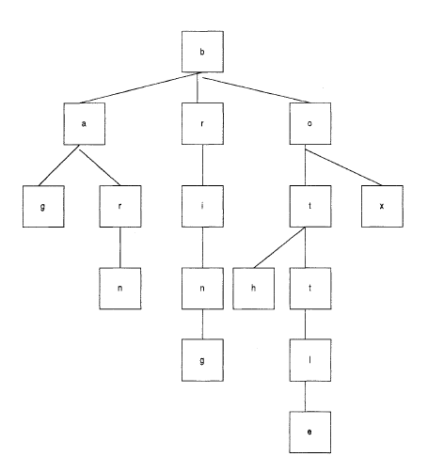
SUCCESSOR STEMMERS
Symbol Tree for terms bag, barn, bring, box, bottle, both

Slide 21

SUCCESSOR STEMMERS
The successor varieties of a word are used to segment a word by applying one of the following four methods :
Cutoff method: a cutoff value is selected to define stem length. The value varies for each possible set of words.
Peak and Plateau: a segment break is made after a character whose successor variety exceeds that of the character immediately preceding it and the character immediately following it.
Complete word method: break on boundaries of complete words.
Entropy method: uses the distribution of successor variety letters. Let |Dak| be the number of words beginning with the k length sequence of letters a. Let
|Dakj| be the number of words in Dak with successor j.

Slide 22

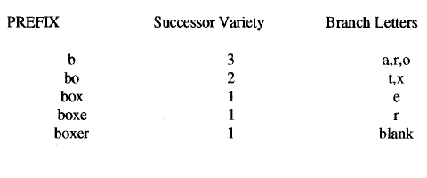
SUCCESSOR STEMMERS
Using the words in above figure plus additional word “boxer”, the successor stemming is shown below.
Example for Successor Variety Stemming
If the cutoff method with value four was selected then the stem would be “boxe”. The peak and plateau method can not apply because the successor variety monotonically decreases. Applying the complete word method the stem is “box”. The example given does not have enough values to apply the entropy method.

Slide 23

INVERTED FILE STRUCTURE
DATA STRUCTURES
The most common data structure used in both database management and Information Retrieval Systems is the inverted file structure.
Inverted file structures are composed of three basic files:
The document file
The inversion lists (sometimes called posting files)
The dictionary.

Slide 24

INVERTED FILE STRUCTURE
Document File: Each document in the system is given a unique numerical identifier. It is that identifier that is stored in the inversion list.
The inversion list: inversion of the document from the perspective that, for each word, a list of documents in which the word is found in is stored (the inversion list for that word).
The dictionary: The Dictionary is typically a sorted list of all unique words (processing tokens) in the system and a pointer to the location of its inversion list. Dictionaries can also store other information used in query optimization such as the length of inversion lists.

Slide 25

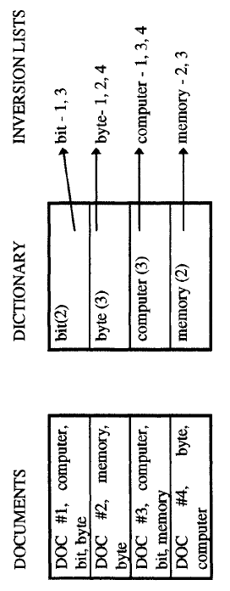
INVERTED FILE STRUCTURE
Inverted File Structure

Slide 26

INVERTED FILE STRUCTURE
Additional information may be used from the item to increase precision and provide a more optimum inversion list file structure.
Example: if zoning is used, the dictionary may be partitioned by zone.
When a search is performed, the inversion lists for the terms in the query are located and the appropriate logic is applied between inversion lists.
The result is a final hit list of items that satisfy the query.
Rather than using a dictionary to point to the inversion list, B-trees can be used. The inversion lists may be at the leaf level or referenced in higher level pointers

Slide 27

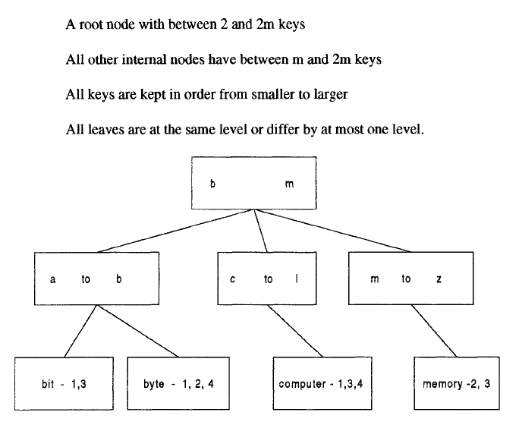
INVERTED FILE STRUCTURE
B-Tree Inversion Lists

Slide 28

N-GRAM DATA STRUCTURES
N-Grams can be viewed as a special technique for conflation (stemming) and as a unique data structure in information systems.
N-Grams are a fixed length consecutive series of "n" characters.
Unlike stemming that generally tries to determine file stem of a word that represents the semantic meaning of the word, n-grams do not care about semantics.
Instead they are algorithmically based upon a fixed number of characters.
The searchable data structure is transformed into overlapping n-grams, which are then used to create the searchable database.

Slide 29

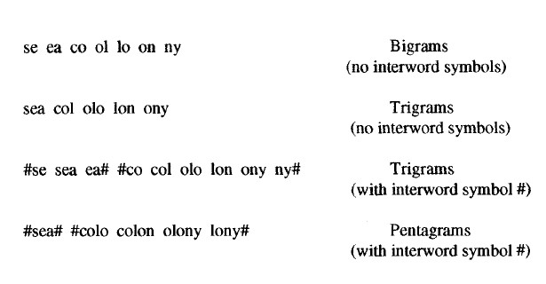
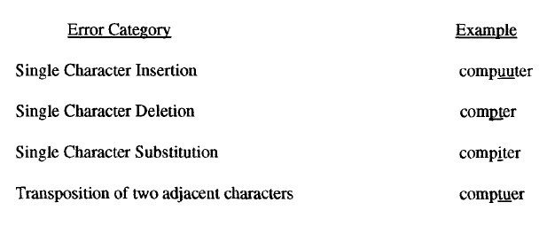
N-GRAM DATA STRUCTURES
Bigrams, Trigrams and Pentagrams for "sea colony"
Categories of Spelling Errors

Slide 30

N-GRAM DATA STRUCTURES
Although there is a savings in the number of unique processing tokens and implementation techniques allow for fast processing on minimally sized machines, false hits can occur under some architectures.
Example: A system that uses trigrams and does not include inter word symbols or the character position of the n-gram in an item finds an item containing "retain detail" when searching for "retail" (i.e., all of the trigrams associated with "retail" are created in the processing of "retain detail").

Slide 31

PAT DATA STRUCTURE
A different view of addressing a continuous text input data structure comes from PAT trees and PAT arrays.
The input stream is transformed into a searchable data structure consisting of substrings.
The original concepts of PAT tree data structures were described as Patricia trees and have gained new momentum as a possible structure for searching text and images and applications in genetic databases.
PAT is short for Patricia Trees (PATRICIA stands for Practical Algorithm To Retrieve Information Coded In Alphanumerics.)

Slide 32

PAT DATA STRUCTURE
In creation of PAT trees each position in the input string is the anchor point for a sub-string that starts at that point and includes all new text up to the end of the input.
All substrings are unique
A substring can start at any point in the text and can be uniquely indexed by its starting location and length.
These substrings are called sistring (semi-infinite string).

Slide 33

PAT DATA STRUCTURE
A PAT tree is an unbalanced, binary digital tree defined by the sistrings.
The individual bits of the sistrings decide the branching patterns with zeros branching left and ones branching right. PAT trees also allow each node in the tree to specify which bit is used to determine the branching via bit position or the number of bits to skip from the parent node. This is useful in skipping over levels that do not require branching.
The key values are stored at the leaf nodes (bottom nodes) in the PAT Tree.

Slide 34

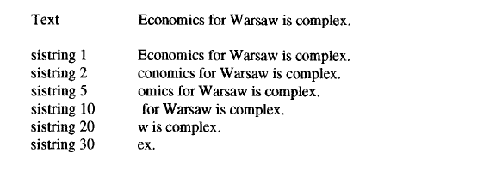
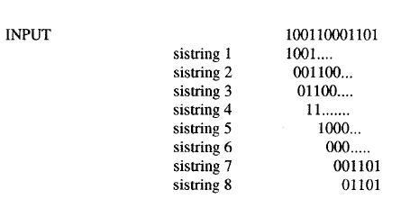
EXAMPLE
Sistrings for input "100110001101"
"h" is (100), "o" is (110), "m" is (001) and "e" is (101)

Slide 35

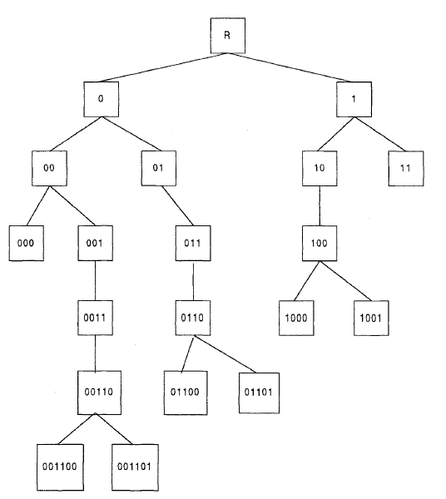
PAT Binary Tree for input "100110001101"

Slide 36

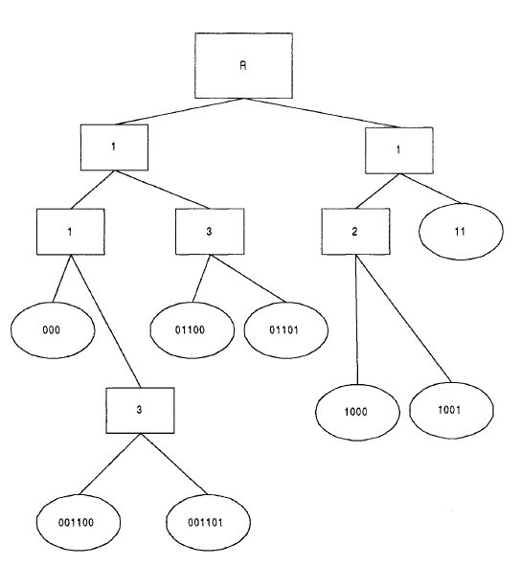
PAT Tree skipping bits for "100110001101"

Slide 37

SIGNATURE FILE STRUCTURE
The goal of a signature file structure is to provide a fast test to eliminate the majority of items that are not related to a query.
The items that satisfy the test can either be evaluated by another search algorithm to eliminate additional false hits or delivered to the user to review.
The text of the items is represented in a highly compressed form that facilitates the fast test.
Because file structure is highly compressed and unordered, it requires significantly less space than an inverted file structure and new items can be concatenated to the end of the structure versus the significant inversion list update.

Slide 38

SIGNATURE FILE STRUCTURE
The surrogate signature search file is created via superimposed coding. The coding is based upon words in the item.
The words are mapped into a "word signature”.
A word signature is a fixed length code with a fixed number of bits set to "1”. The bit positions that are set to one are determined via a hash function of the word.
The word signatures are ORed together to create the signature of an item. To avoid signatures being too dense with "l"s, a maximum number of words is specified and an item is partitioned into blocks of that size.
The block size is set at five words ,the code length is 6 bits and the number of bits that are allowed to be “1” for each word is five.

Slide 39
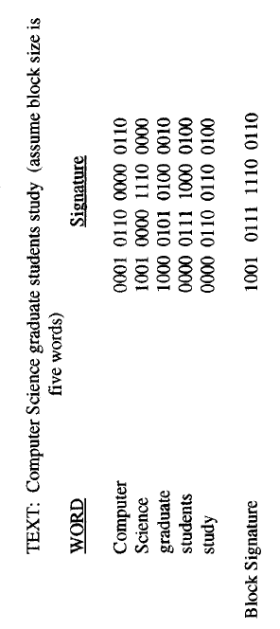
SIGNATURE FILE STRUCTURE
Example : Superimposed Coding

Slide 40

SIGNATURE FILE STRUCTURE
The words in a query are mapped to their signatures. Search is accomplished by template matching on the bit positions specified by the words in the query.
The signature file can be stored as a signature with each row representing a signature block. Associated with each row is a pointer to the original text block.
A design objective of a signature file system is trading off the size of the data structure versus the density of the final created signatures.
Signature files provide a practical solution for storing and locating information in a number of different situations.

Slide 41

HYPERTEXT DATA STRUCTURE
The advent of the Internet and
its exponential
growth and wide acceptance as
a new global
information network has introduced
a new
mechanism for representing information.
This structure is called hypertext and differs from traditional information storage data structures in format and use.
The hypertext is stored in Hypertext Markup Language (HTML) and eXtensible Markup Language(XML).
HTML is an evolving standard as new requirements for display of items on the Internet are identified and implemented.

Slide 42
HYPERTEXT DATA STRUCTURE
The hypertext data structure is used extensively in the Internet environment and requires an electronic media storage for the item
Hypertext allows one item to reference another item via an imbedded pointer. Each separate item called a node and reference pointer is called a link.
For example Hypertext Markup Language defines the internal structure for information exchange across the World Wide Web on the Internet.
A document is composed of the text of the item along with HTML tags that describe how to display the document.
Tags are formatting or structural keywords contained between less-than, greater than symbols (e.g,<title>,<strong> meaning display prominently).

Slide 43
HYPERTEXT DATA STRUCTURE
The eXtensible Markup Language(XML) is starting to become a standard data structure on the WEB.
Its objective is extending HTML with semantic information.
The logical data structure within XML is defined by a Data Type Description(DTD)and is not constrained to the 70 defined tags and 50 attributes in the single DTD for HTML.
The user can create any tags needed to describe and manipulate their structure. The W3C is redeveloped HTML as a suite of XML tags
The following a simple example of XML tagging:
<company>Widgets Inc</company>
<city>Boston</city>
<state>Mass</state>
<product>widgets</product>

Slide 44

CATALOGING AND INDEXING

Slide 45

HISTORY AND OBJECTIVES OF INDEXING
Indexing (originally called Cataloging) is the oldest technique for identifying the contents of items to assist in their retrieval.
The objective of cataloging is to give access points to a collection that are expected and most useful to the users of the information.

Slide 46

HISTORY
Up to the 19th Century there was little advancement in cataloging, only changes in the methods used to represent the basic information
In 1963 the Library of Congress initiated a study on the computerization of bibliographic surrogates.
From 1966 - 1968 the Library of Congress ran its MARC I(MAchine Readable Cataloging) pilot project
The system became operational in 1969.
The earliest commercial cataloging system is DIALOG, which was developed by Lockheed Corporation in 1965 for NASA. It became commercial in 1978 with three government files of indexes to technical publications. By 1988, when it was sold to Knight-Ridder.
In the 1990s, the significant reduction in cost of processing power and memory in modern computers, along with access to the full text of an item.

Slide 47

OBJECTIVES
The objectives of indexing have changed with the evolution of Information Retrieval Systems.
Represent the concepts within an item to facilitate the user’s finding relevant information
The full text searchable data structure for items in the Document File provides a new class of indexing called total document indexing.
Do we need manual indexing at all?
Manual indexing provides a mechanism for standardization of index terms (i.e. use of a controlled vocabulary)
Slow indexing but simple search process
Total document indexing (uncontrolled vocabulary)
Fast indexing but difficult search process
Other objectives of indexing – ranking, item clustering

Slide 48

ITEMS OVERLAP BETWEEN FULL ITEM INDEXING, PUBLIC FILE INDEXING, AND PRIVATE FILE INDEXING
Public Index File
Private Index File
Document File

Slide 49

INDEXING PROCESS

Slide 50

OVERVIEW
When an organization with multiple indexers decides to create a public or private index, some procedural decisions on how to create the index terms assist the indexer and end users in knowing what to expect in the index file
Scope of the indexing : define what level of detail the subject index will contain
Based on usage scenarios of the end users
Pre Coordination and Linkages: The need to link index terms together in a single index for a particular concept
Needed when there are multiple independent concepts found within an item

Slide 51

SCOPE OF INDEXING
When performed manually, the process of reliably and consistently determining the bibliographic terms that represent the concepts in an item is extremely difficult
Vocabulary domains of indexer and author may be different
Results in different quality level of indexing
Two factors involved in deciding on what level to index the concepts in an item
Exhaustivity
Specificity

Slide 52

EXHAUSTIVITY AND SPECIFICITY
Exhaustivity : The extent to which concepts in the item are indexed.
the different
Example: If two sentences of a 10-page item on Computer discusses hardware components, should this concept be indexed?
Specificity : the preciseness of the index terms used in indexing
Ex: Whether “processor” or “microcomputer” or “pentium” should be used
Low exhaustivity has an adverse effect on both precision and recall
Low specificity has an adverse effect on precision, but no effect to a potential increase in recall

Slide 53

SCOPE OF INDEXING (CONT.)
What portions of an item should be indexed
Only title or title + abstract ? (low precision and recall)
Weighting of index terms is not common in manual indexing
Weighting is the process of assigning an importance to an index term’s use in an item
The weight should represent the degree to which the concept associated with the index term is represented in the item
The weight should help in discriminating the extent to which the concept is discussed in items in the database

Slide 54

PRECOORDINATION AND LINKAGE
Whether linkage are available between index terms for an item
Used to correlate related attributes associated with concepts discussed in an item
The process of creating term linkages at index creating time is called pre-coordination
Postcoordination – coordinating terms at search time by ANDing index terms together, which only finds indexes that have all of the search term
Factors that must be determined in the linkage process are the number of terms that can be related, any ordering constraints on the linked terms, and any additional descriptors are associated with the index terms

Slide 55

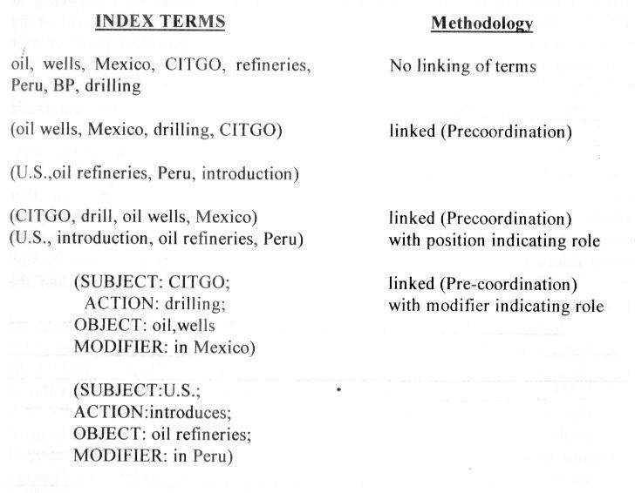
LINKAGE OF INDEX TERMS
Drilling of oil wells in Mexico by CITGO and the introduction of oil refineries in Peru by the U.S.

Slide 56

AUTOMATIC INDEXING

Slide 57

OVERVIEW
Automatic indexing is the capability to automatically determine the index terms to be assigned to an item
Simplest case: total document indexing
Complex: emulate a human indexer and determine a limited number of index terms for the major concepts in the item
Human indexing VS. automatic indexing
Adv: ability to determine concept abstraction and judge the value of a concept
Disadv: cost, processing time, and consistency
Usually take at least five minutes per item
Automatic indexing: weighted and un-weighted; indexing by term and indexing by concept

Slide 58

UN-WEIGHTED AUTOMATIC INDEXING
The existence of an index term in a document and sometimes its word location(s) are kept as part of the searchable data structure
No attempt is made to discriminate between the value of the index terms in representing concepts in the item
Not possible to tell the difference between the main topics in the item and a casual reference to a concept
Query against un-weighted systems are based on Boolean logic and the items in the resultant Hit file are considered equal in value.

Slide 59

WEIGHTED AUTOMATIC INDEXING
An attempt is made to place a value on the index term’s representation of its associated concept in the document
An index term’s weight is based on a function associated with the frequency of occurrence of the term in the item
Values for the index terms are normalized between zero and one
The higher the weight, the more the term represents a concept discussed in the item

Slide 60

WEIGHTED AUTOMATIC INDEXING (CONT.)
The query process uses the weights along with any weights assigned to terms in the query to determine a rank value used in predicting the likelihood that an item satisfies the query
Thresholds or a parameter specifying the maximum number of items to be returned are used to bound the number of items returned to a user

Slide 61

INDEXING BY TERM
The terms of the original item are used as a basis of the index process
Two major techniques: statistical and natural language
Statistical techniques
Calculation of weights use statistic information such as the frequency of occurrence of words and their distributions in the searchable DB
Vector models and probabilistic models
Natural language processing
Process items at the morphological, lexical, semantic, syntax, and discourse levels
Each level uses information from the previous level to
perform its additional analysis
Events, and event relationships

Slide 62

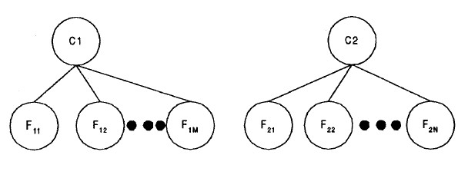
STATISTICAL TECHNIQUES (BAYESIAN NETWORK )
A Bayesian network is a directed acyclic graph in which each node represents a random variable and the arcs between the nodes represent a probabilistic dependence between the node and its parents.
Two-level Bayesian network
C1 and C2 represent "the item contains concept Ci" and the F nodes represent "the item has feature (e.g., words) Fij.“

Slide 63

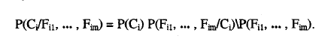
The goal is to calculate the probability of Ci given Fij. To perform that calculation two sets of probabilities are needed:
The prior probability P(C) that an item is relevant to concept C
The conditional probability P(Fij/Ci) that the features Fij where j = 1, m are present in an item given that the item contains topic Ci.
The Bayes inference formula that is used is:

Slide 64

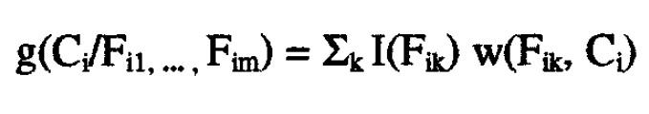
If the goal is to provide ranking as the result of a search by the posteriors, the Baye’s rule can be simplified to a linear decision rule:
where I(Fik) is an indicator variable that equals 1 only if Fik is present in the item (equals zero otherwise) and w is a coefficient corresponding to a specific feature/concept pair.

Slide 65

NATURAL LANGUAGE PROCESSING
The DR-LINK (Document Retrieval through Linguistic Knowledge) system processes items at the morphological, lexical, semantic, syntactic, and discourse levels.
Each level uses information from the previous level to perform its additional analysis. The discourse level is abstracting information beyond the sentence level and can determine abstract concepts using pre- defined models of event relationships.

Slide 66

INDEXING BY CONCEPT

Slide 67

INDEXING BY CONCEPT
Concept indexing determines a canonical set of concepts based upon a test set of terms and uses them as a basis for indexing all items This is also called Latent Semantic Indexing because it is indexing the latent semantic information in items. The determined set of concepts does not have a label associated with each concept (i.e., a word or set of words that can be
used to describe it), but is representation (e.g., a vector).
Ex: Math Plus System by HNC Inc.
a mathematical

Slide 68

MATH PLUS SYSTEM
The MatchPlus system
uses neural networks to
facilitate machine learning of concept/word relationships and sensitivity to similarity of use.
The systems goal is to be able to determine from the corpus of items, word relationships (e.g., synonyms) and the strength of these relationships and use that information in generating context vectors.
Two neural networks are used. One neural network learning algorithm generates stem context vectors that are sensitive to similarity of use and another one performs query modification based upon user feedback.

Slide 69

INFORMATION EXTRACTION
There are two processes associated with information extraction:
Determination of facts to go into structured fields in a database.
# Subset of the important facts in an item may be identified and extracted
Extraction of text that can be used to summarize an item.
#All of the major concepts in the item should be represented in the summary.

Slide 70

The process of extracting facts to go into indexes is called Automatic File Build.
Its goal is to process incoming items and extract index terms that will go into a structured database. This differs from indexing in that its objective is to extract specific types of information versus understanding all of the text of the document.
An Information Retrieval System's goal is to provide an in-depth representation of the total contents of an item.

Slide 71

An Information Extraction system only analyzes those portions of a document that potentially contain information relevant to the extraction criteria.
The objective of the data extraction is in most cases to update a structured database with additional facts. The updates may be from a controlled vocabulary or substrings from the item as defined by the extraction rules.
Additional metrics used are overgeneration and fallout.
Overgeneration measures the amount of irrelevant information that is extracted.
Fallout measures how much a system assigns incorrect slot fillers as the number of potential incorrect slot fillers increases

Slide 72
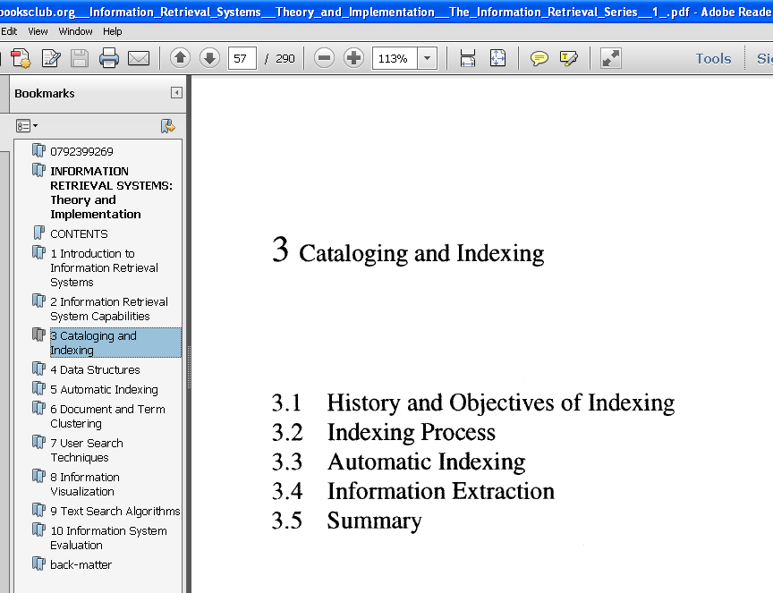

EXAMPLE
Another related information technology is document summarization. Rather than trying to determine specific facts, the goal of document summarization is to extract a summary of an item maintaining the most important ideas while significantly reducing the size.
Example: Part of any item are titles, table of contents, and abstracts with the abstract being the closest.

